Slide 1





PREDICT CUSTOMER PERSONALITY TO BOOST MARKETING CAMPAIGN BY USING MACHINE LEARNING
Presented by Arini Arumsari

Slide 2

PROJECT OVERVIEW
“ A company can develop rapidly when it knows the behavior of it’s customer personality, so that it can provide better services and benefits to customers who have the potential to become loyal customers. By processing historical marketing campaign data to improve performance and target the right customers, so they can transcat on the company’s platform, from this data insight our focus is to create a cluster prediction model to make it easir for companies to make decisions. “

Slide 3
Data Exploratory

Slide 4
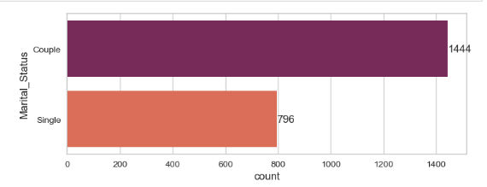
Number of Customers by Marital Status
Based on the graph of the number of customers by marital status for a company. The graph shows that the company has the most customers who are married or have a domestic partnership, followed by single customers. The company also has a small number of customers who are divorced, widowed, or separated.

Slide 5
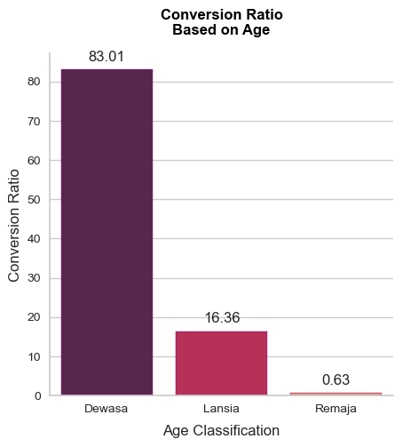
Number of Customers by Age
As you can see, the Dewasa age group has the highest number of customers and the highest conversion ratio. The Lansia age group has a lower number of customers and a lower conversion ratio. The Remaja age group has the fewest customers and the lowest conversion ratio.
This information suggests that the company may want to focus its marketing efforts on the Dewasa age group, as they are the most likely to make a purchase.

Slide 6
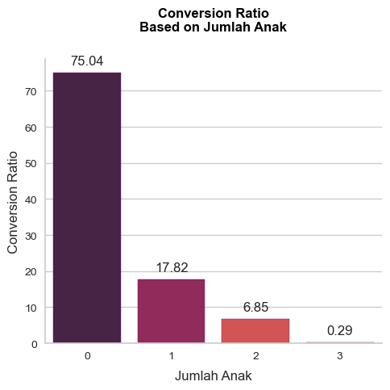
Customers by Number of Children
The data points on the graph show that the conversion ratio is highest for customers with no children, and it decreases as the number of children increases. Here are the specific data points:
0 children: 75.04% conversion ratio
1 child: 17.82% conversion ratio
2 children: 6.85% conversion ratio
3 children: 0.29% conversion ratio
This suggests that families with no children are most likely to make a purchase, while families with three or more children are least likely to make a purchase

Slide 7
Preprocessing

Slide 8




Preprocessing
Data
Cleaning
Feature Engineering
Feature
Encoding
Feature
Transformation
Describe the methods you used to collect and analyze data
Process of transforming raw data into features
Transform the
categorical values
into numerical
ones
Transform the
data to the normal
distribution

Slide 9
Data Modeling

Slide 10
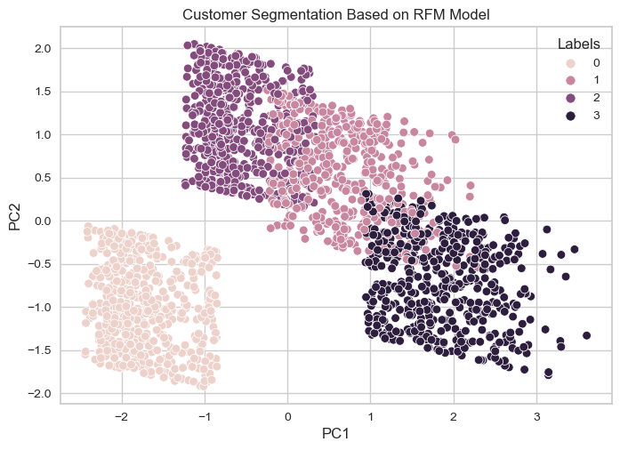
Clustering
We will classify the customer by creating a
cluster with the following steps:
Perform dimensionality reduction
using Principal Component Analysis (PCA)
Determine the number of the
cluster using Elbow Method
Label the customer cluster using
K-Means Clustering

Slide 11
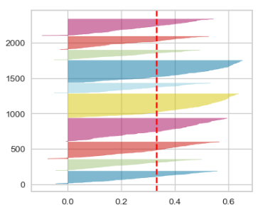
Evaluate Model
We use silhouette score to evaluate the
model performance. From the graph we can
find out several things:
The average silhouette score is 0.3
All the clusters are above the average
silhouette score
The cluster size are fairly distributed
We can conclude the model is good.

Slide 12
Customer Personality Analysis for Marketing Retargeting

Slide 13
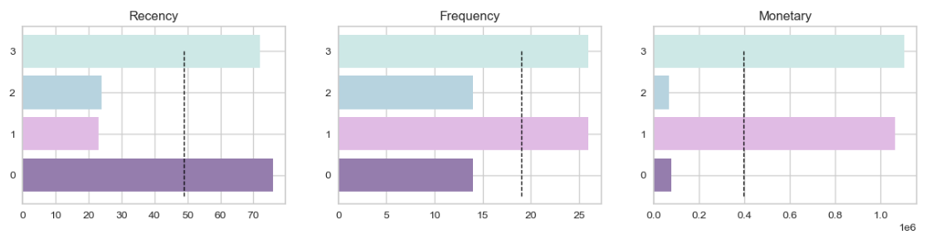
Insights for each feature:
R, Recency: The higher the frequency value, the more often the customer makes a purchase.
F, Total_Purchases: The higher the frequency value, the more often the customer makes a purchase.
M, total Purchases: The higher the monetary value, the more money the customer spends on purchases.

Slide 14
Cluster Profile
Cluster 0: Most Loyal Customers
Customers in this cluster have not interacted with the business in 74 days, but they have the highest spending. This suggests that they are very loyal to the business and are likely to continue to make purchases in the future.
Cluster 1: New Customers
Customers in this cluster have only interacted with the business in the last 22 days, but they have a high purchase frequency and spending. This suggests that they are new to the business and are still exploring its products or services.
Cluster 2: Impactful Customers
Customers in this cluster have only interacted with the business in the last 24 days, but they have a low purchase frequency and spending. However, their spending is still significant, suggesting that they are valuable customers.
Cluster 3: Passive Customers
Customers in this cluster have not interacted with the business in 73 days, but they have a high purchase frequency and spending. This suggests that they are still engaged with the business, but they may be looking for new products or services.

Slide 15
Recommendation

Slide 16
Cluster 3 & Cluster 1: These clusters are good targets for retargeting due to their high purchase frequency and spending. Marketing strategies can focus on offering exclusive offers or purchase bonuses to increase customer loyalty in these groups.
If we calculate the potential impact of focusing on retargeting marketing on Cluster 3 and Cluster 1, then the total spending we will receive is Rp 626,855,000 for Cluster 3 and Rp 557,668,000 for Cluster 1, with a potential impact of 46.33% and 41.21%.
This means that if we target these two clusters with retargeting marketing, we could expect to increase sales by 46.33% for Cluster 3 and 41.21% for Cluster 1.
Total Spent of Cluster 0: Rp 88453000
Total Spent of Cluster 1: Rp 557668000
Total Spent of Cluster 2: Rp 80137000
Total Spent of Cluster 3: Rp 626855000
Total Spent: Rp 1353113000
Potential Impact of Cluster 3: 46.33%
Potential Impact of Cluster 1: 41.21%

Slide 17



A WARM
THANK YOU
TO ALL OF YOU!
Link
Link
Link

